Slide 1


GOLD EXPLORATION & EXPLOITATION
West Gabal Elbah Project
Southern Eastern Desert
EGYPT
July 2024

Slide 2

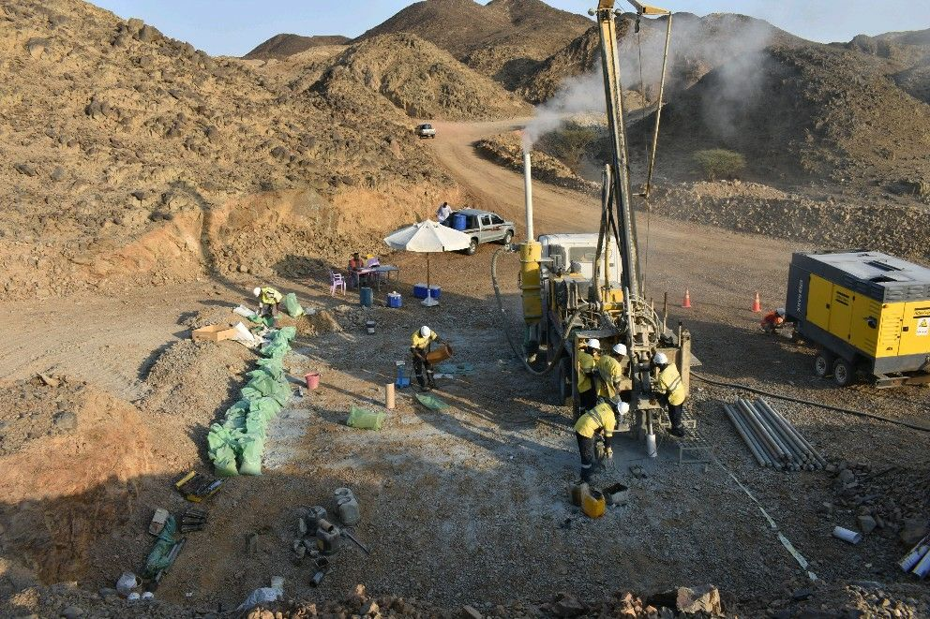

West Gabal Elbah (WGE) Project
Drilling Operation

Slide 3
Presentation Outlines:
AFAQ Mining & Concession in Brief.
Main Contractual Terms.
Exploration Progress & Main Achievements.
Mapping The Exploration Progress to International Standards.
Investment & Expenditure to date.
Gold Resource Target.
Proposed Work Plan (Main Items & Schedule).
Required Budget for Romeit Target #2 Prospect Evaluation.
Management & Technical Team.
Company Vision for the Production Facilities and Area Advantages.
Conclusions.

Slide 4
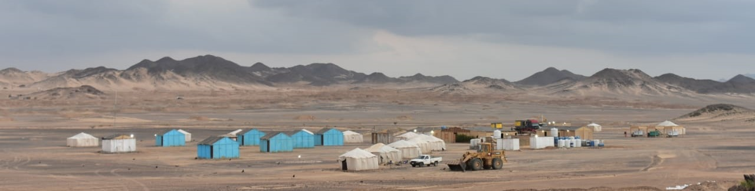
AFAQ Mining In Brief
Egyptian company
Right to explore and exploit gold and associated minerals in West Gabal Elbah Concession area
agreement with Shalateen Mineral Resources Co. (SMRC)

Slide 5
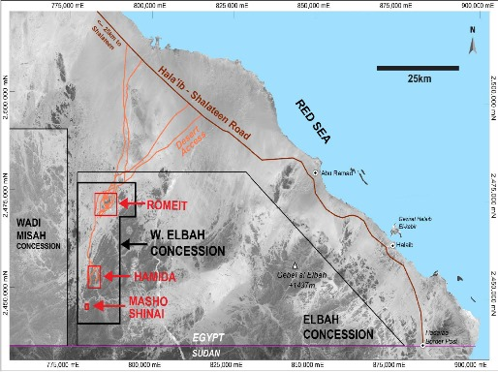
WGE Project Overview
Location: South Eastern Desert, Egypt
Current Area : 510 Sq. Km
The area has 3 historical gold occurrences represents the first exploration targets for the company:
Romeit (38 sq. Km )
Hemida (23 sq. Km)
Masho Shinai (2 sq. Km)
Relinquished Area
Several other exploration targets identified by fieldwork and remote sensing - including Warabit, surrounding areas of J. Gruror and Sorrouk extension.

Slide 6
Main Contractual Terms of the Agreement:
5% Royalty from the total production.
60% from the remaining represents the Cost Recovery pool for all pre & post Exploration and Operating expenses in full, if less, the remaining expenditure to be carry forward.
The remaining net profit to be split equally between AFAQ Mining as one party & both (EMRA & SRMC) as the other party.
AFAQ Mining has the right to sell the produced gold to the international market.
AFAQ Mining taxes will be paid by Shalateen Co. on our behalf,
(from their profit share).

Slide 7
AFAQ Mining – Business Strategy
Ensure application of best industry practices and recognised QA/QC standards
Very efficient project costing, effective management, close evaluation of reults.
Achieved through:
Employ competent technical staff and field crew with involved and experienced Management.
Conduct work program to meet recognised standard (NI 43-101) for all technical reporting and disclosure.
Employ international (Canada) technical consultants to advise and supervise exploration work program
All QA/QC for work program conducted by Canadian expert.
All analyses conducted at certified laboratory (ALS Romania) & cooperation with ODM Canada, Kiel UNIV. Lab Germany).
Complete, validated database for all available data sets.

Slide 8
Exploration Progress and Main Achievements:
Established field camp and operations office in Shalateen, SE Egypt.
Satellite Imagery Acquisition and Interpretation has been completed by UK expert Dr. C.W. Baker.
Regional geological field work completed by AFAQ field crew - including trenching and grab samples and assaying of 12,000 samples at ALS (Romania)
Detailed Field surface Geological Mapping has been completed for the Romeit target area.
Paved 2/3 of high-quality roads out of 35 Km target for heavy equipment mobilization.
Completed Reverse Circulation (RC) drilling program of 7000m (55 borehole).
All assay results integrated into dataset, used in evaluation of economic potential.
Generate 3D modeling for the drilling results, incorporate surface trench results.
Plan and start diamond drilling program, currently completed 4000m (19 holes) of 15000m program.
Received the assay for 15 drill holes to date with very promising assay results.

Slide 9
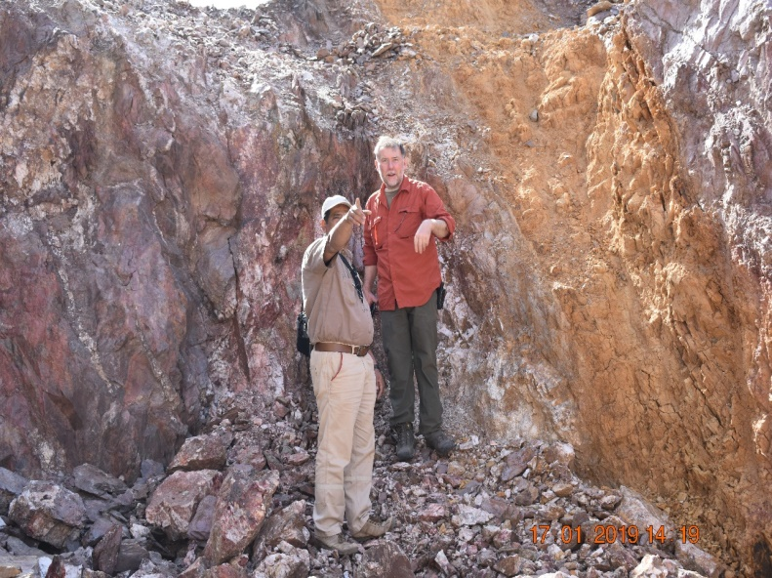
Detailed Field Mapping
Regional lithological and structural mapping (from remote sensing study) covering the entire Concession area.
Detailed Lithological and Structural Mapping on 1:500 scale for Romeit Prospect to understand the structure, alteration, gold mineralization
style.
Details categorized - geological and structural
features, lithology, veining,, dykes,
alteration types and intensity,
mineralization characteristics and distribution,
shear zones indicators, faulting, folding
Deformation history.

Slide 10
Understanding of Gold Mineralization System
Gold Mineralisation:
Individual gold grains recovered from placer deposits associated with Romeit target.
Abundant gold grains recovered.
Physical characteristics of grains indicate that they originated in nearby lode mineralisation at the Romeit occurrence.
Gold Grain from Romeit Alluvial
(source: ODM Canada)

Slide 11
Highlights on some RC Samples Assay results
More than 12,000 new grab samples collected from main Romeit, South Romeit and Hamida prospects.
7000 samples obtained from RC drilling.
In total 19000 samples analysed – all analyses conducted at ALS, Romania.
Assay results indicate widespread, prospective gold mineralisation and very encouraging gold grades in most of the drilled prospects. Romeit occurrence particularly well endowed. Many targets remain to be tested.
Widespread strongly anomalous analytical results – many multigram analyses, locally >100 Au g/t.
Current focus is to quantify the gold mineralisation at the Romeit occurrence through RC and diamond drilling programs.

Slide 12
Drilled Targets & Holes
T # 5
T # 1
T # 7
T # 6
T # 3
T # 4
T # 2

Slide 13
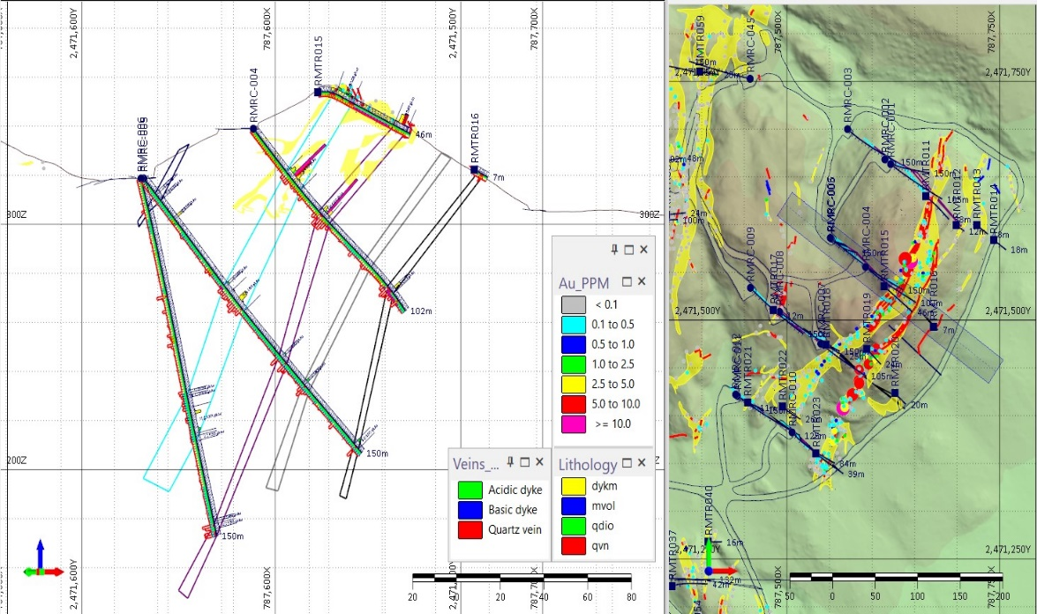
WG Elbah Project, South Romeit Area RC Drilling Observations

Slide 14
WG Elbah Project,
South Romeit Area
RC Drilling Cross Section
Pink denotes quartz diorite country rock
Orange denotes gold mineralised deformation zone
Note: mineralisation is open to depth.

Slide 15
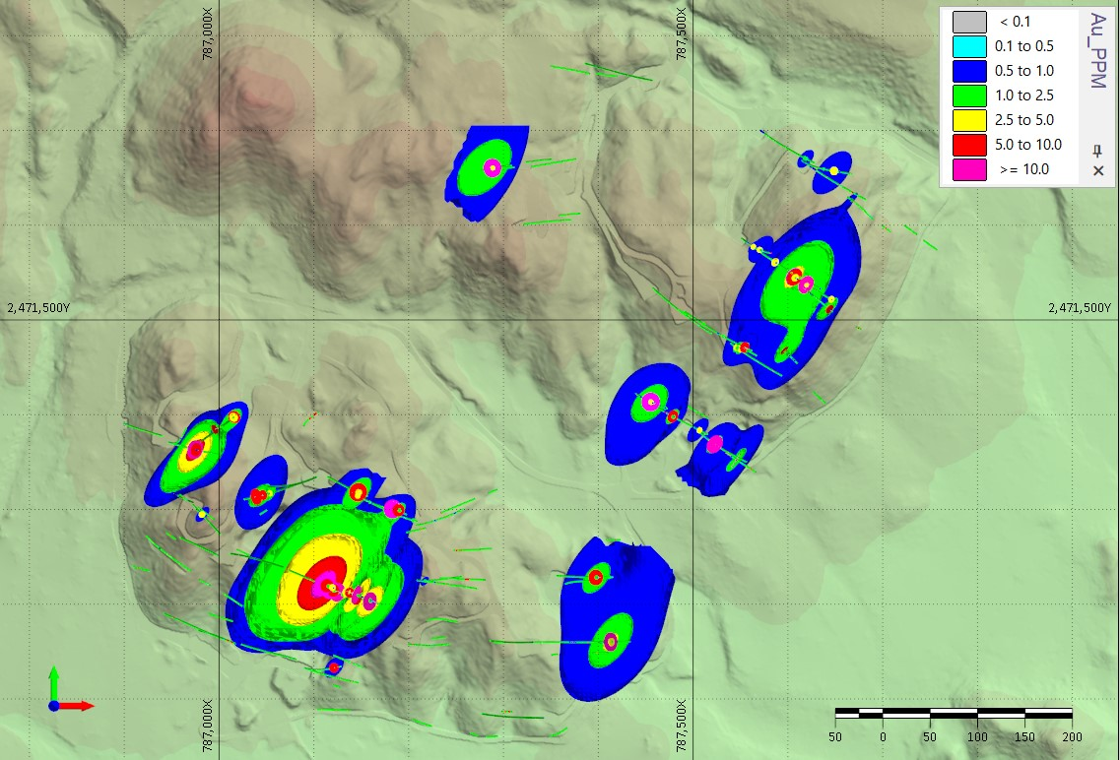
WG Elbah Project, South Romeit Area & RC Drilling Observations
Two main trends for gold mineralization
NE-SW trend intersects with mineralized trend oriented NW-SE trend
Intersection may result in higher grade gold mineralized domain.
Prime exploration target.
NE-SW
T # 5
NW-SE
T # 7
T # 1
T # 6
T # 3
T # 2
T # 4

Slide 16
HoleID | Sample_No | Depth_From | Depth_To | Au-AA23_25
RMRC-004 | 644280 | 26 | 27 | 19.25
RMRC-004 | 644303 | 48 | 49 | 20.6
RMRC-010 | 643586 | 32 | 33 | 11.2
RMRC-012 | 643327 | 70 | 71 | 43.9
RMRC-015 | 645358 | 121 | 122 | >100
RMRC-016 | 645994 | 36 | 37 | 9.82
RMRC-016 | 646048 | 86 | 87 | 48.7
RMRC-017 | 646117 | 47 | 48 | 15.7
RMRC-018 | 645907 | 107 | 108 | >100
RMRC-018 | 645910 | 109 | 110 | 54.9
RMRC-018 | 645911 | 110 | 111 | 30
RMRC-025 | 646242 | 41 | 42 | 8.89
RMRC-025 | 646243 | 42 | 43 | 67.7
RMRC-039 | 654516 | 121 | 122 | 20.2
RMRC-044 | 655404 | 46 | 47 | 28.6
RMRC-047 | 655781 | 106 | 107 | 24.6
RMRC-047 | 655782 | 107 | 108 | 30.4
RMRC-047 | 655786 | 111 | 112 | 13.85
RMRC-047 | 655791 | 116 | 117 | 26.7
RMRC-047 | 655798 | 123 | 124 | 23.2
RMRC-047 | 655799 | 124 | 125 | 14.15
RMRC-047 | 655800 | 125 | 126 | 17.95
RMRC-047 | 655801 | 126 | 127 | 45
RMRC-047 | 655803 | 128 | 129 | 32.9
RMRC-048 | 655941 | 125 | 126 | 21
RMRC-048 | 655942 | 126 | 127 | 9.53
RMTR-005 | 28038 | 44.1 | 45.1 | 56.7
RMTR-023 | 28367 | 13.7 | 14.4 | 15
RMTR-026 | 28441 | 13.1 | 14.6 | 33.1
RMTR-071 | 636384 | 7.2 | 8.1 | 16.7
8 - 25 G/T | 25 - 50 G/T | 50 - 75 G/T | 75 - >100 G/T

Slide 17
Assay results of grab & RC samples Indicate the following:
Demonstrates at surface the widespread presence of structurally hosted gold mineralisation in domains measured in kilometres in length, tens of metres wide.
Drilling indicates good gold mineralization extends to depth and is open below the current depth of drill testing.
Drill results have locally exceeded expectations – causing reevaluation drill targets and reordering of drilling priorities.
Drilling program will particularly focus on Target 2 at Romeit occurrence.
Targets 3 and 4 at Romeit also present significant potential.

Slide 18
Forward Exploration Work Plan
Diamond drilling (15000m) and RC drilling (7000m) are planned in targets 2, 3 and 4 at the Romeit occurrence. Diamond drilling commenced September 2023.
Currently, 18 diamond drill holes are complete, assays received for 13 holes, work is ongoing.
Perform detailed structural geology study for the whole Romeit area.
Conduct environmental study to ensure compliance and in preparation for more detailed economic evaluation.
Plan to conduct studies in parallel - structure, resource evaluation, metallurgy, rock mechanics, mine design, processing. All studies needed for feasibility study prior the any announcement of commercial viability.

Slide 19
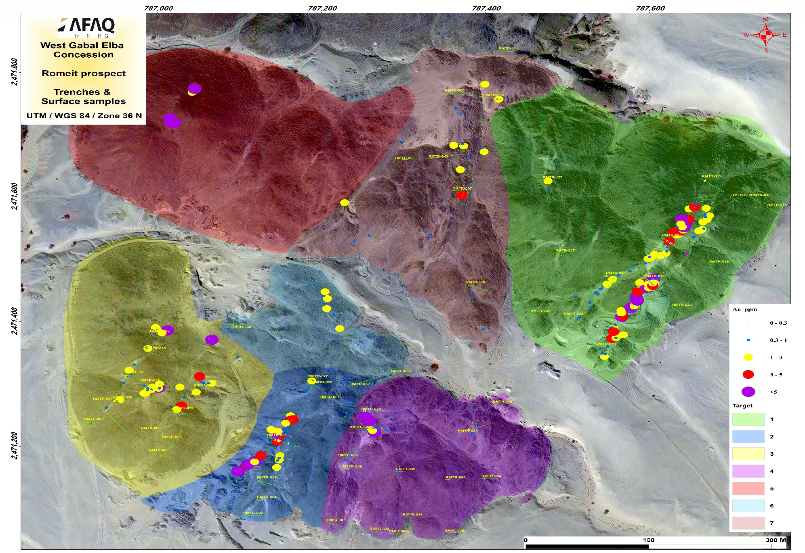
First year work plan current position
Domain #2
Domain #2

Slide 20

AFAQ Mining Gold Resource Target
AFAQ Mining is targeting a one million oz of gold resource in the area as company vision.
We believe that the area contains much more than one million oz based on:
  the technical studies to date
  available assay data
  identified gold mineralization
  Recorded historical activities and data recorded
  we plan to confirm as much as possible with the current on-going technical program.
Exploration and development programs will continue after announcement of a commercial discovery to add further resources from the prospective and essentially unexplored Romeit, Hemida & Masho Shinai occurrences.

Slide 21

AFAQ Future Production Plan & Advantages
AFAQ Mining is targeting to be a major gold producing company in Egypt, taking advantage of the attributes of the WGE:
Easy access and logistics - about 35 Km from asphalt road, and about 70 km to the Shalateen City.
Source of water for production is desalination from Red Sea (about 50 km, flat topography), will reduce the cost of water pipeline and hence the cost of production,
Plan to build 2 water desalination stations one for gold production facility and another for Shalateen as part of Community Support Responsibility (CSR) commitment.
Plan to use solar energy (where feasible) as green energy source for to supply the project.
Excellent relation with the authorities and local community in Shalateen City.
Low mining cost due to ease of access, low topographic relief, proximity of potential open pits (for potential targets).

Slide 22
Presentation Outcomes
Presence of widespread gold mineralisation in occurrences - high grade, significant width and strike length.
High potentiality of gold can be identified by RC and diamond drilling in south Romeit area using 25 * 25 m hole spacing testing to 150 metres depth.
The current diamond drilling program is focused on attaining a resource for announcement of commercial viability.
Structurally hosted gold deposits can be anticipated to extend to >1km depth as interpreted by Prof. Basem Zoheir (Keil University in Germany).
Expanding drill coverage to greater depth than so far achieved will likely result in delineation of additional gold mineralisation.
Proceed with the work plan and focus on infill RC & diamond drilling to ensure and verify the gold mineralisation already identified – lead t a commercial announcement.

